Slide 1

Finding Parking spots in vicinity.
Team Name: Random-6
Team Leader: Kartik Chawda
Mentor: Mrunali Desai, Bhavin Goswami
College name: KJSIEIT
Email id:chawdakartik@gmail.com

Slide 2
WTPL
Where’s The Parking Lot?

Slide 3
Assumptions and Cost
User: An integrated dashboard(Rs.4000)
/smartphone
Datasets: From webscraping and crowdsourcing are genuine.
Man power for operating the system.
Parking lot Owner: Arduino with add-on modules: approx Rs. 700
Rf Id scanner(Rs. 100)
Rf card(Rs. 2)
Paytm account.

Slide 4



REGISTER
LOGIN
USER
AVAILABLE
PARKING SLOT
<<INCLUDE>>
PROVIDE
PARKING
DETAILS
WTPL
Book Online/Cash payment
GPS
ASK FOR FEEDBACK

Slide 5
Features
Provides multiple parking spots
within the chosen radius
Shows occupancy
Polling
Frugal
Scalable
Provide data through Api service to agencies like CBI

Slide 6
Features
Booking through online payment
Dashboards for Admin,Parking lot owner
Criminal case enquiry Dashboard
User gets to add
his parking spot (Crowdsourcing)

Slide 7
ADMIN PANEL
Login
Add new parking spot
Admin
WTPL
Delete parking spot

Slide 8
PARKING LOT PANEL
Login
Enter in time
Admin
WTPL
Enter out time

Slide 9
CBI PANEL
Login
Search
Admin
WTPL

Slide 10
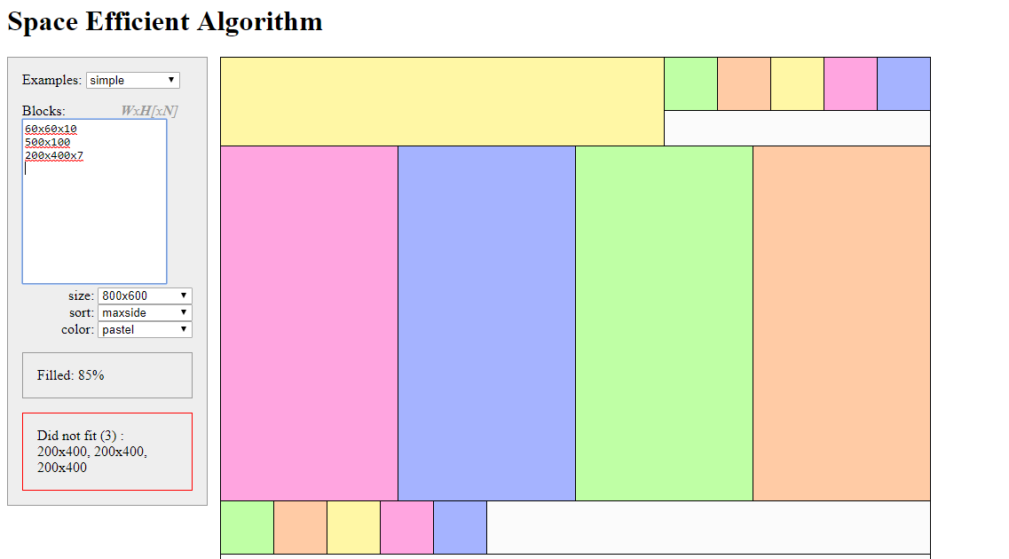

Slide 11
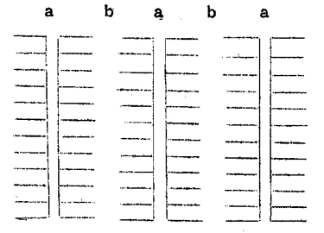
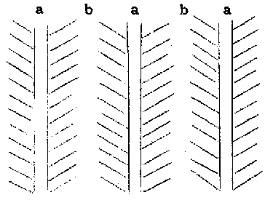
Arrangement

Slide 12
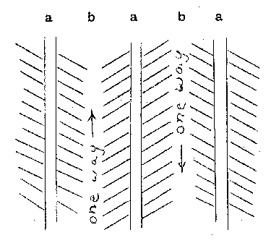
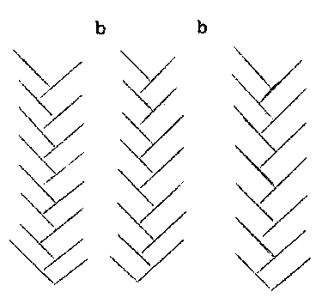
Arrangement

Slide 13
Future scope
Provides statistical data of particular parking lot at particular time
Live number of users navigating to the same parking lot
Voice interaction
Cheap Automation of parking lot

